Slide 1
The Generalized Fractal Dimensions of Floating Particles on the
Surface of a Turbulent Tank of Water
Jason Larkin
Department Mechanical Engineering and Materials Science, University of Pittsburgh.
Mahesh M. Bandi
Center for Nonlinear Studies and Condensed Matter & Thermal Physics Division,
Los Alamos National Lab.
Walter Goldburg
Department of Physics & Astronomy, University of Pittsburgh.
LA-UR-07-7929

Slide 2
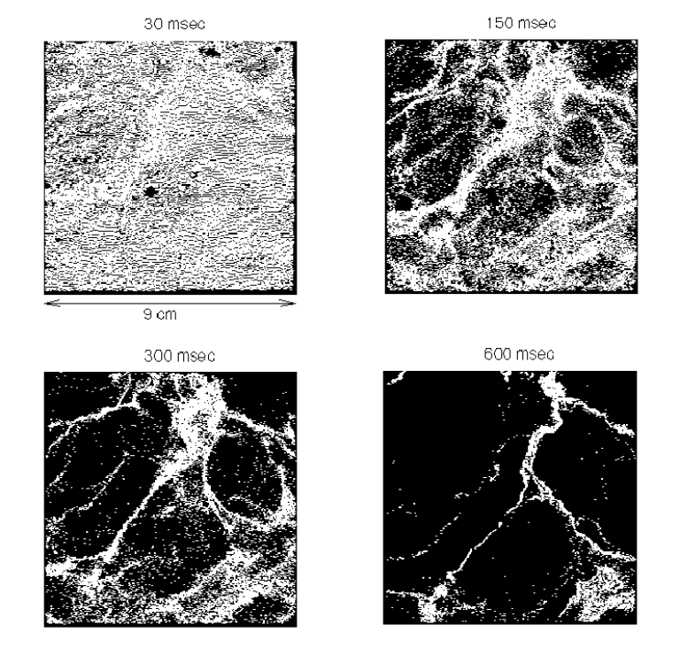
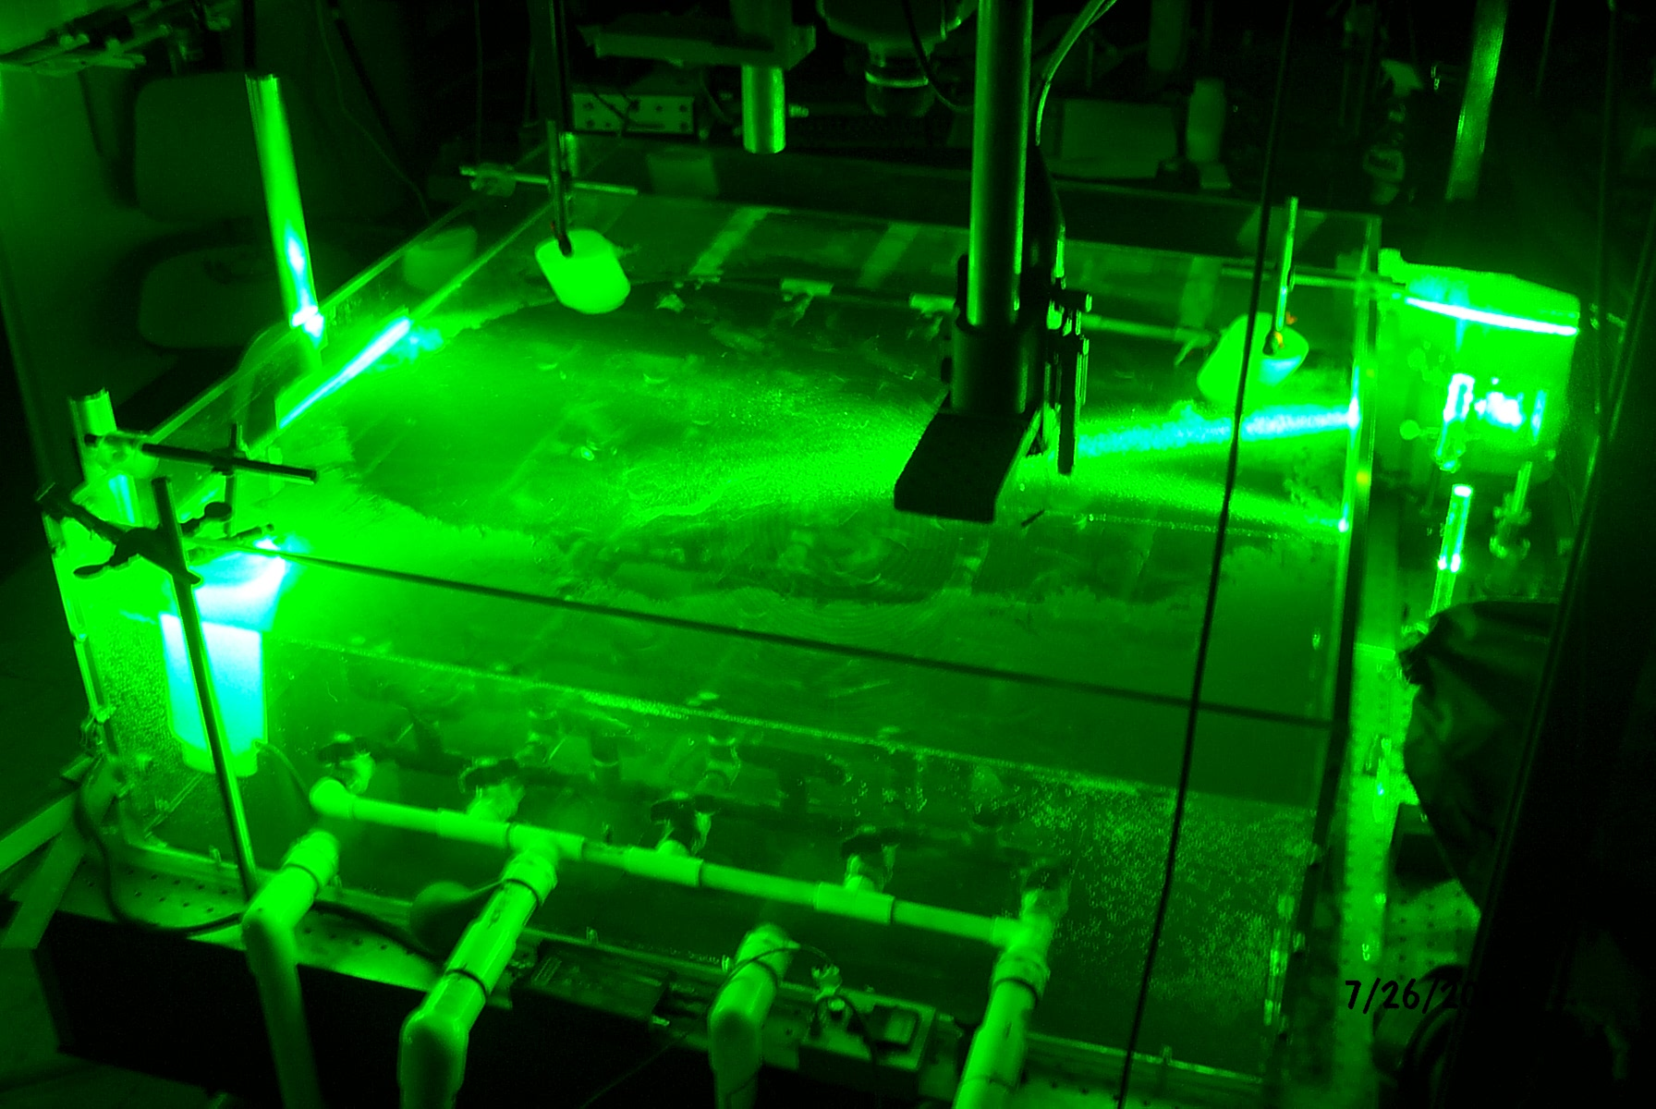
I. Experiment Overview
GOAL: Measure a range of fractal dimensions for 2-D turbulence of floating particles on the surface of a tank of water.
50 micron particles (sg 0.25)
Tank: 1 m x 1 m x 0.3 m driven by 8 hp pump through “sprinkler” system.
~1000-1500 instantaneous velocity fields measured by high-speed camera used to evolve virtual particles
Real particles 50 micron size and highly bouyant (sg 0.25)
LA-UR-07-7929
Notes:
-

Slide 3
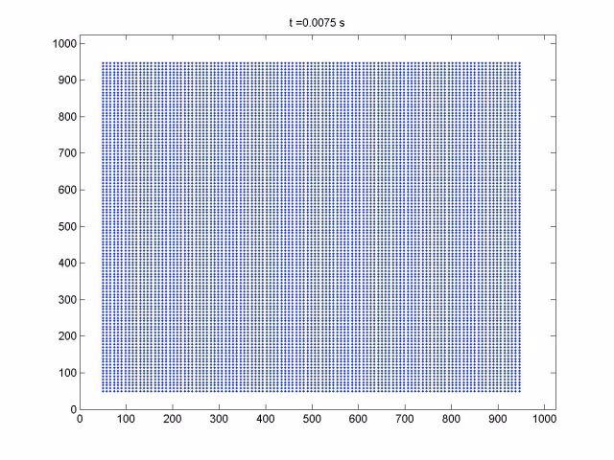
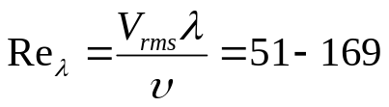
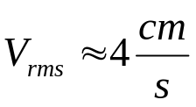

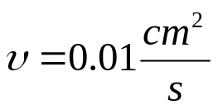
Coagulation of Floaters
-Taylor-Microscale Reynolds Number:
-R.M.S. velocity:
-Taylor Microscale:
-Kinematic Viscosity:
Pump speed (energy injection rate) varied to achieve Re=51-169
At t=0 uniform distribution (of virtual of particles)
Particles are driven by turbulence of water and form a compressible system.
~12,000 particles in Field of View at each instant of time.
LA-UR-07-7929

Slide 4
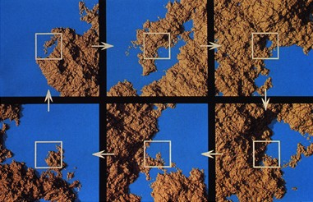
Why Measure Fractal Dimensions?
In dynamical systems fractal dimension gives estimate of number of “active” degrees of freedom.
In geometric sense fractal dimension tells you how “space filling” an object is (configuration or phase space).
What is a fractal?
Has a fractal dimension not equal to its embedding dimension.
Is self-similar or scale-free (object exhibits detail on all length scales).
A. Map of coastline showing detail on different length scales.
LA-UR-07-7929

Slide 5
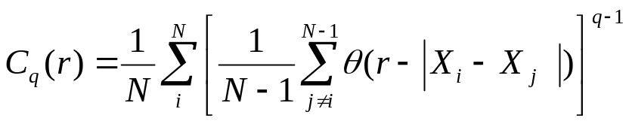
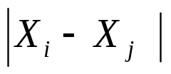

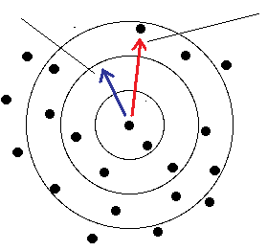

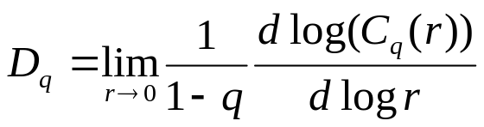
Generalized Fractal Dimensions
Correlation Sum¹:
-Measures probability of finding trajectories within radius r.
-C_{q}(r) depends on r and q.
Heaviside Step Function:
Generalized Fractal Dimension:
-We must find an interval on r where D_q is constant.
-r is non-dimensionalized by the field of view.
¹P. Grassberger and I. Procaccia (1983). "Measuring the strangeness of strange attractors". Physica 9D: 189-208.
LA-UR-07-7929

Slide 6
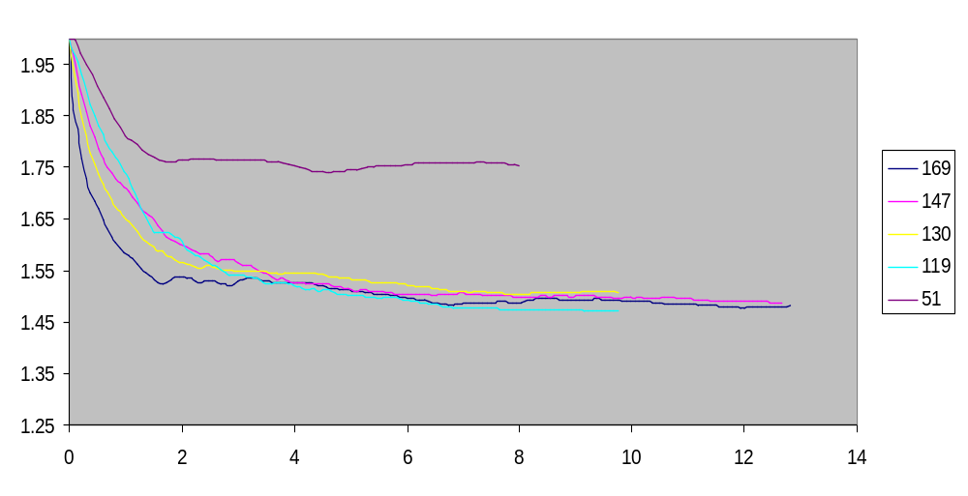



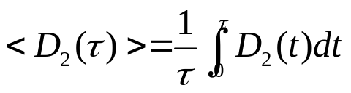
Measurement of D_2(t) for Various Re_{λ}
-At t=0, D_2=2 for all Re (Particles initially on uniform grid).
-Time-averaged value of D_2(t) for increasing averaging time:
-Define:
-Steady-State values of D_2(t) appear independent of Re between 119-169 (within experimental error).
-For Re=51, flow is close to laminar (where D_q(t)=2).
-Subsequent calculations will use an ensemble average of Re=119-169
LA-UR-07-7929

Slide 7
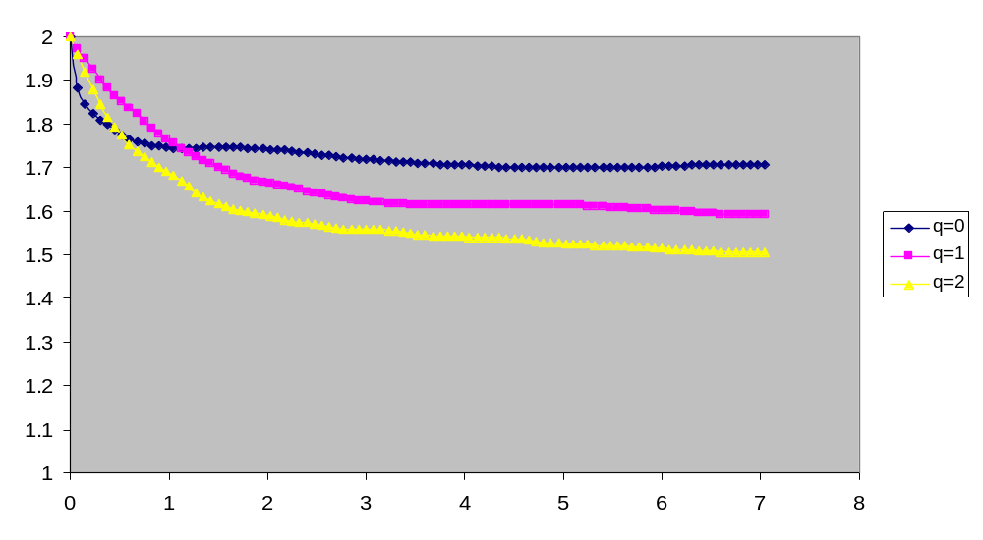

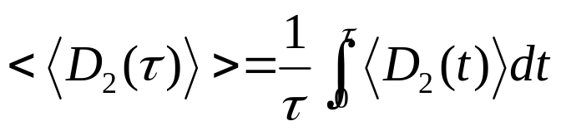
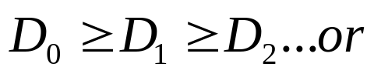
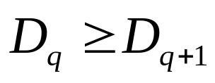
Ensemble Measurement of D_q(t)
Steady-State Values
q | <D_q(t)>
0 | 1.706
1 | 1.591
2 | 1.501
-Ensemble and time average:
-Results presented are ensemble averaged for Reλ=119-169 range and then averaged over increasing t.
-Values for steady-state values of D_q agree with 2-D chaotic maps (such as the Henon Map) where:
LA-UR-07-7929

Slide 8
Results
The time evolution of the fractal dimensions q=0,1,2 have been measured.
Results in the steady-state agree with 2-D chaotic maps for q>=0:
Steady-state value of D_q(t) appears to be independent of Re_{λ} for Re_{λ}= 119-169.
Future Work
Measure D_q(t) for Re_{λ} between 50-120 to determine if there is a “critical” Re_{λ} value where steady-state value of D_q(t) is independent of Re_{λ}
Divide the data into time-uncorrelated sets and investigate decay of D_q(t) for q=0,1,2
LA-UR-07-7929

Slide 9
Questions?
LA-UR-07-7929

Slide 10
Thanks to Mahesh M. Bandi and Walter
Goldburg for guidance.
Dr. Goldburg, I need info on NSF to include them here as well…

